Slide 1
Reservation Approval and Assignment on the Blockchain with Location
Azure PowerApps, Flow, Office 365, Ethereum Connector, Westlake

Slide 2
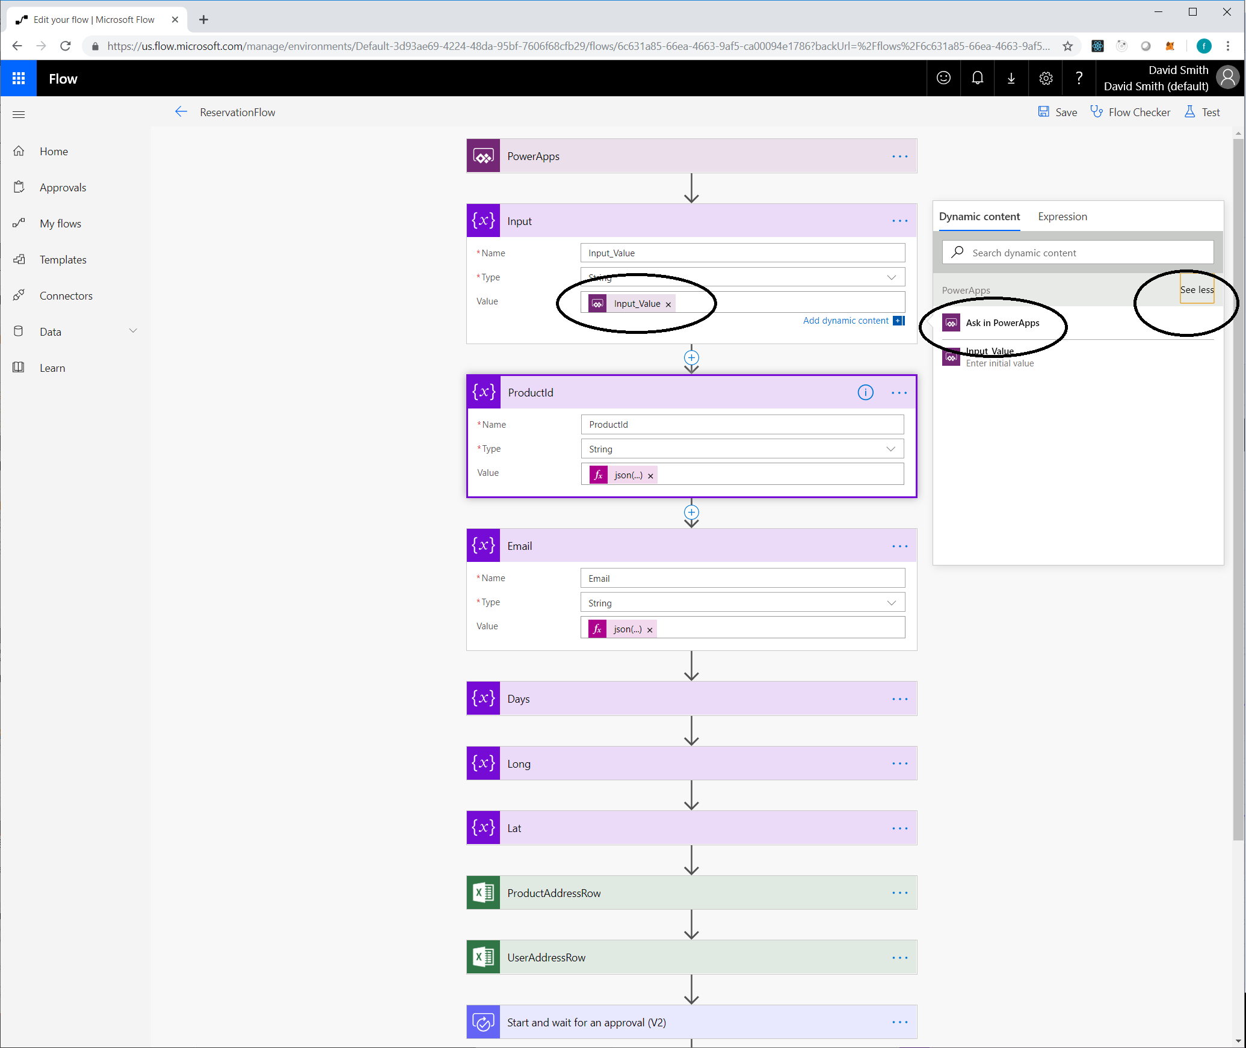
From a PowerApp triggered flow -Initialize a Variable - in the dynamic content Dialog, click See more, then choose Ask in PowerApps

Slide 3
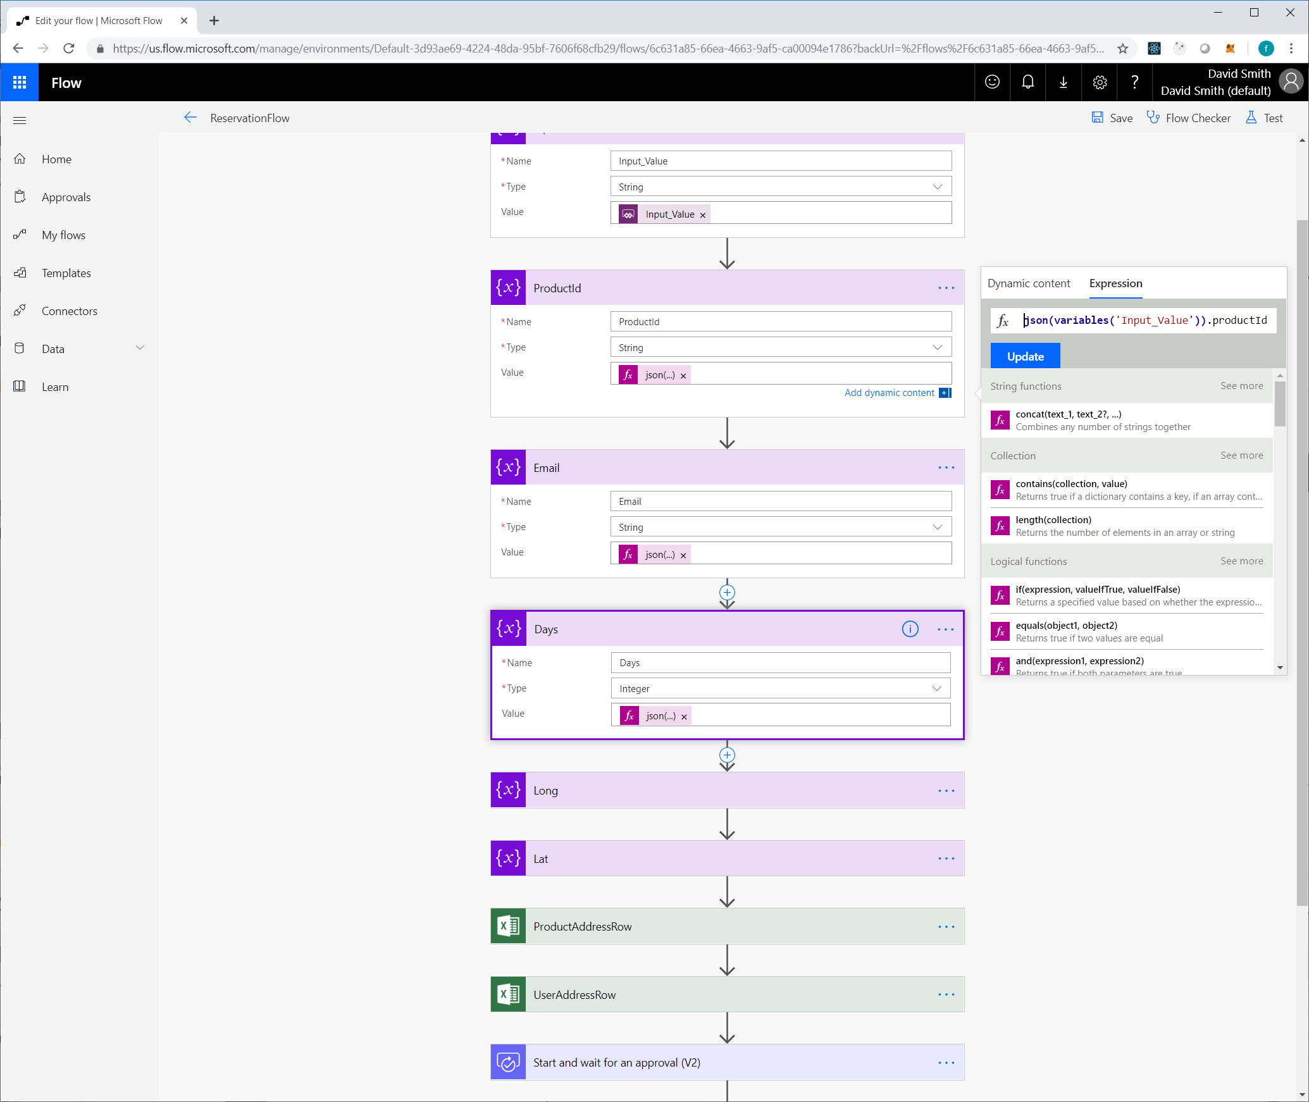
Once PowerApps is setup to pass a JSON string to Flow, you can use an expression to pull the variables out and use them in your actions

Slide 4
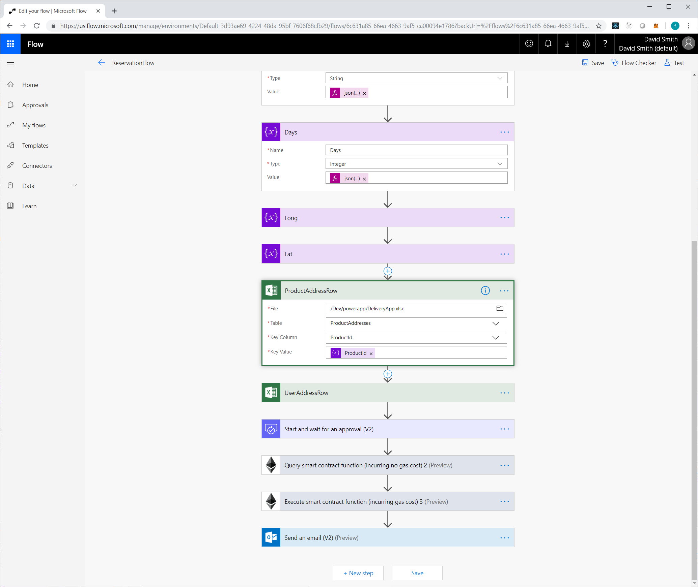
Lookup any other information you need (like blockchain @addresses) from other data sources

Slide 5
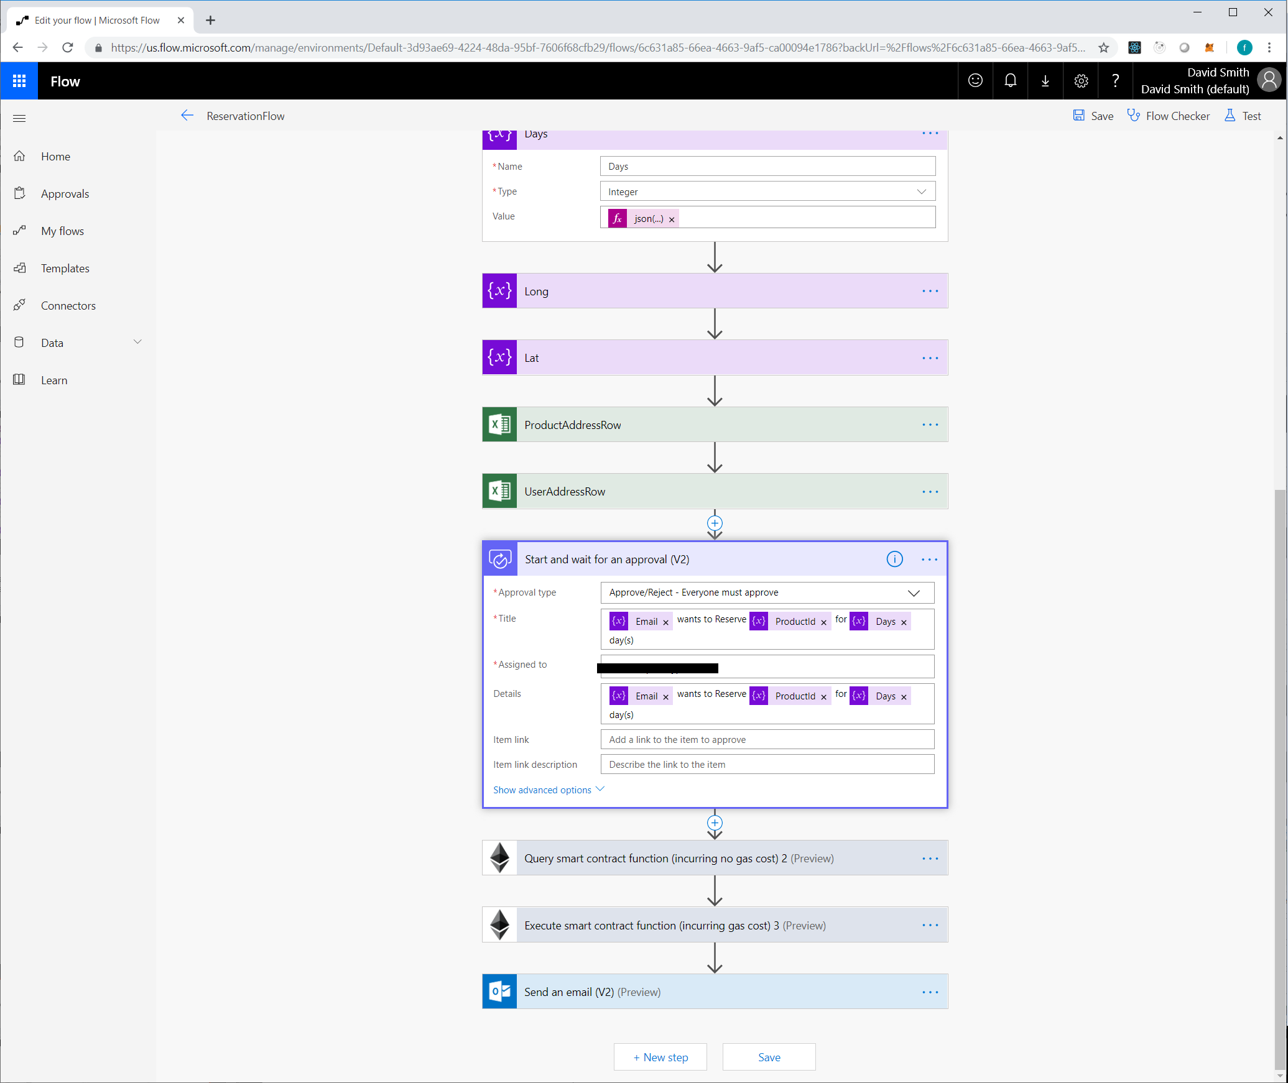
Setup an Approval step if required

Slide 6
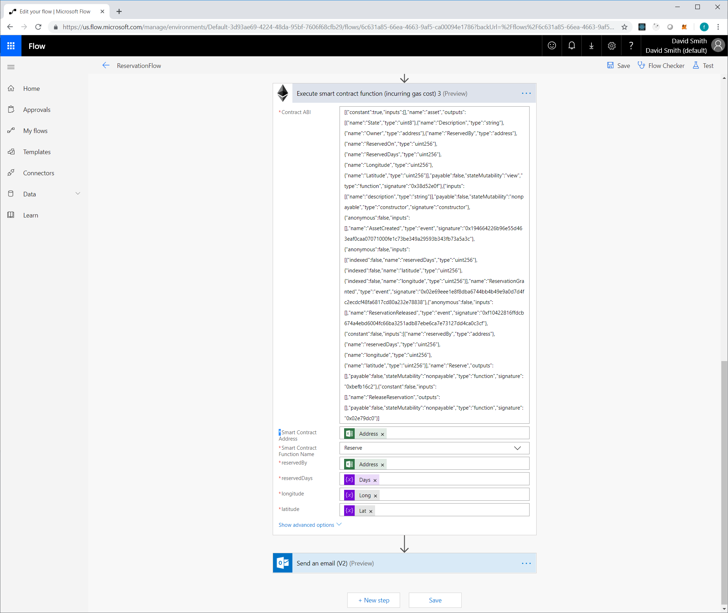
Call the Reservation method on the Product’s contract - (Notice we provided Latitude and Longitude from PowerApps)
Next?
Setup a delay, and automatically rescind the reservation / start overbilling

Slide 7
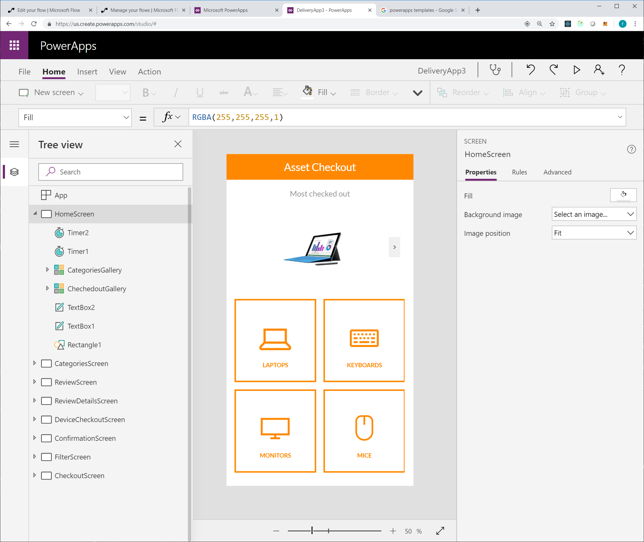
PowerApp
- Start with Asset Checkout Sample

Slide 8
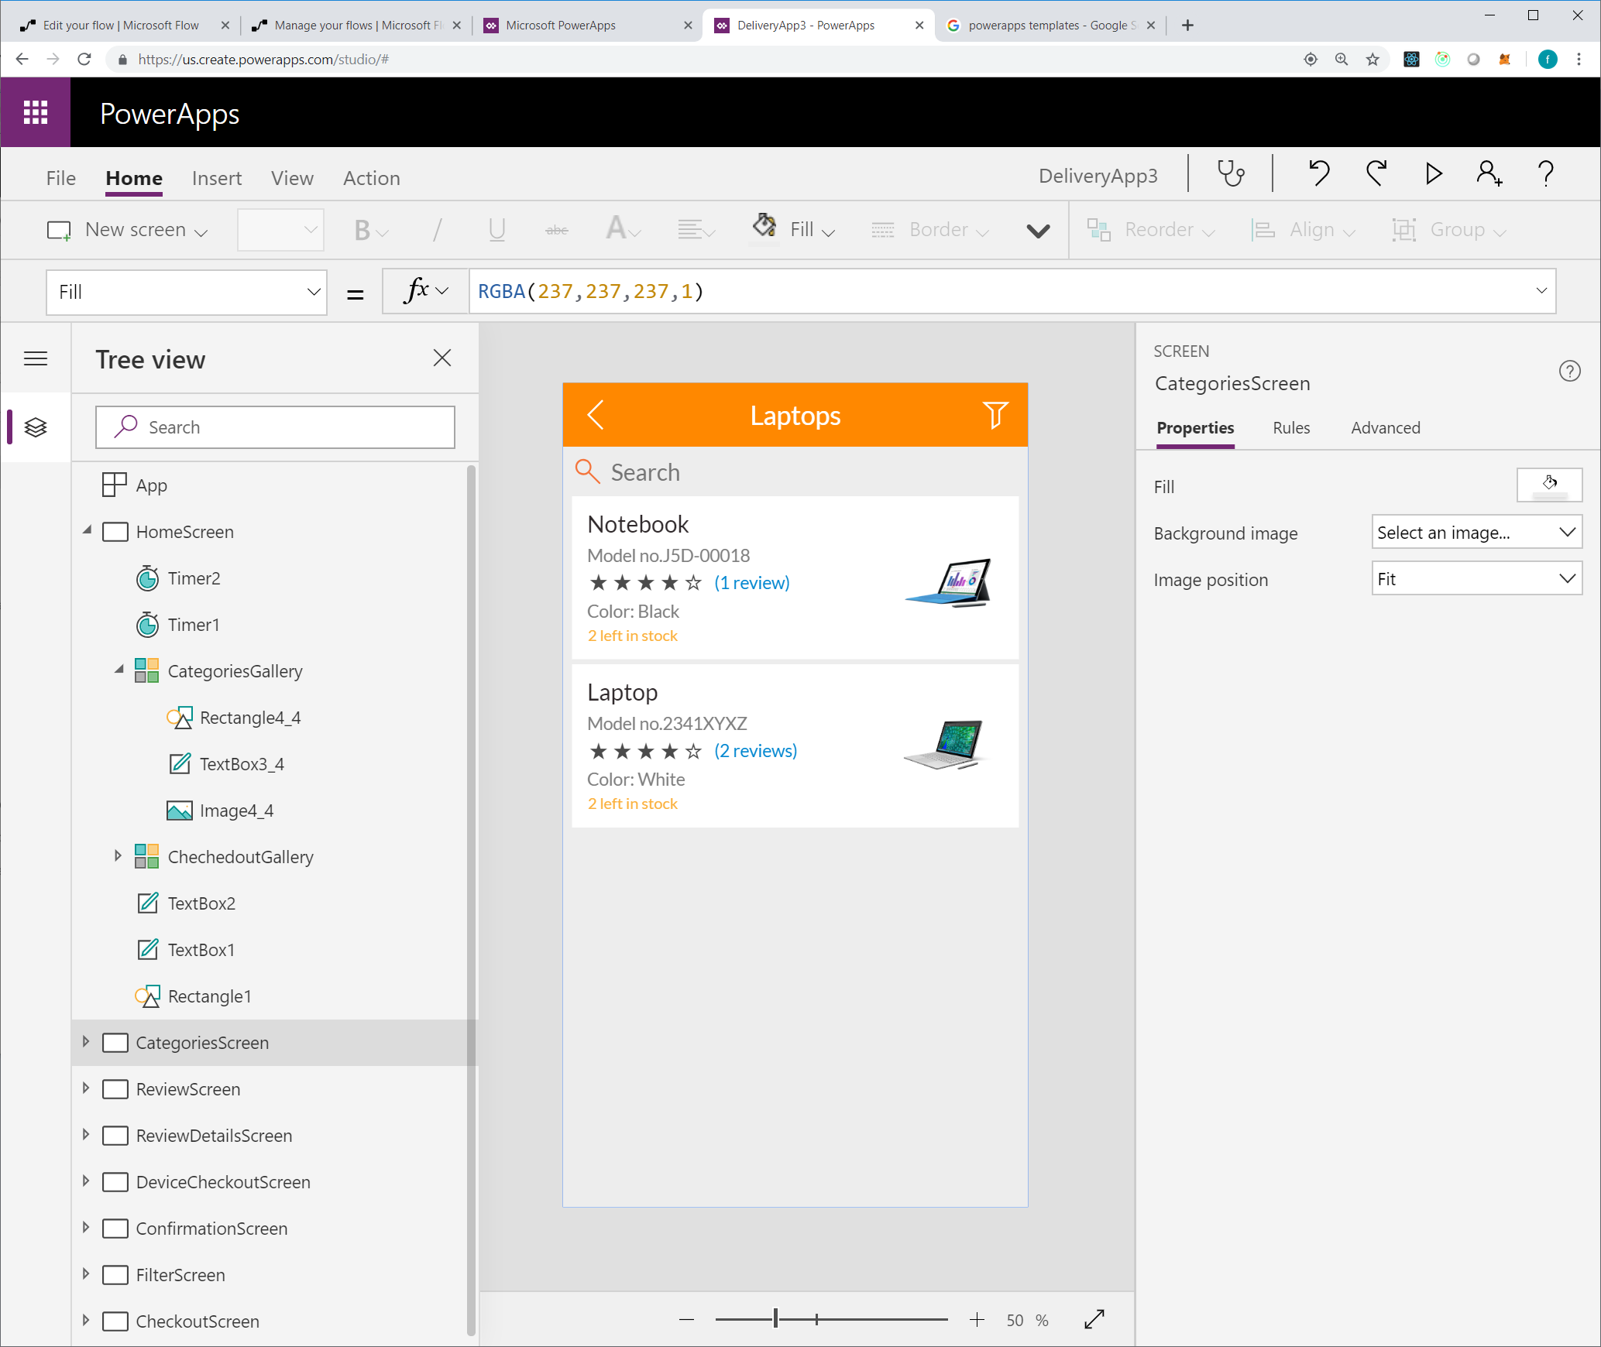

Slide 9
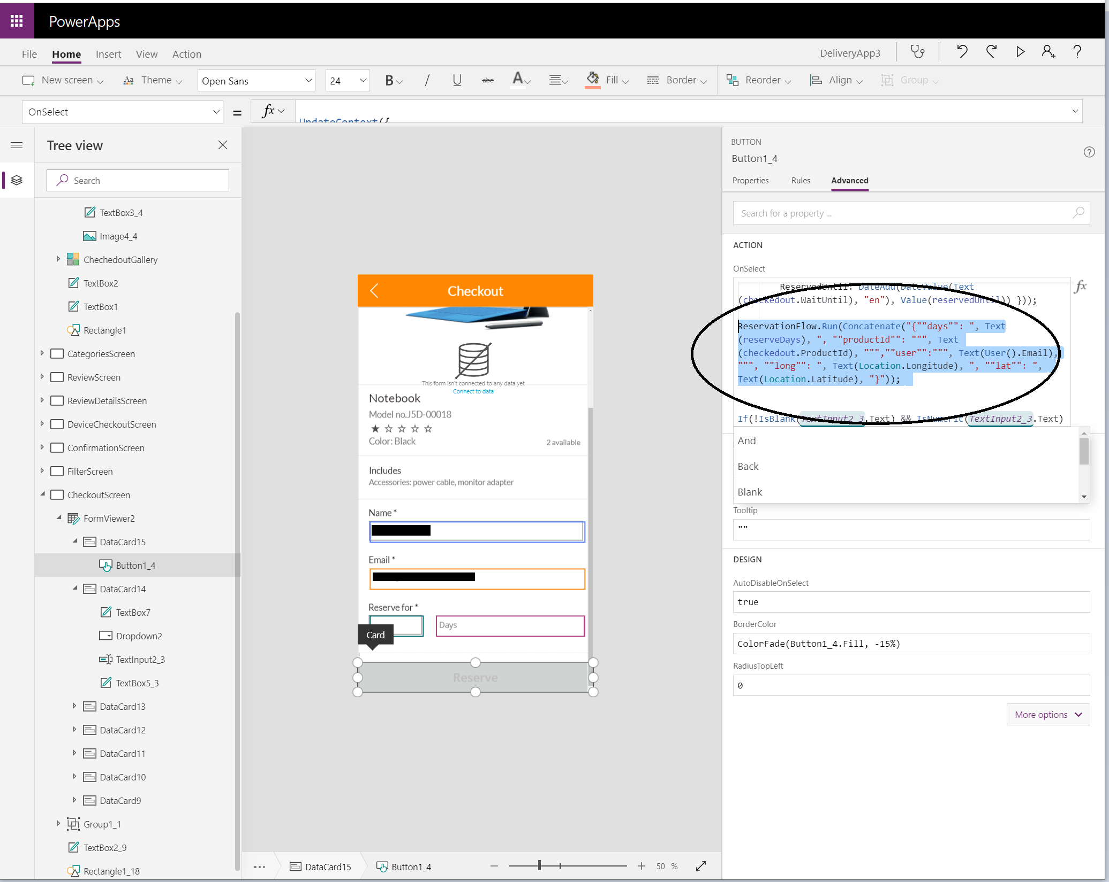
Hook the Reserve button up to Flow, and pass the ProductId, duraction, user, latitude and longitude
From an event, click on Action / Flows and add your previously created Flow to the PowerApp
Call [Flow].Run([JSON STRING])
make sure the string matches the expected parameters in Flow

